Slide 1


Enhancing Size Ratios through forecasting, clustering & classification
13/06/2024

Slide 2
Agenda
01
Introduction & Background
02
Methodology & Project Scope
03
Model Selection & Evaluation
04
Results & Recommendations
05
Risks, Limitations & Implications

Slide 3
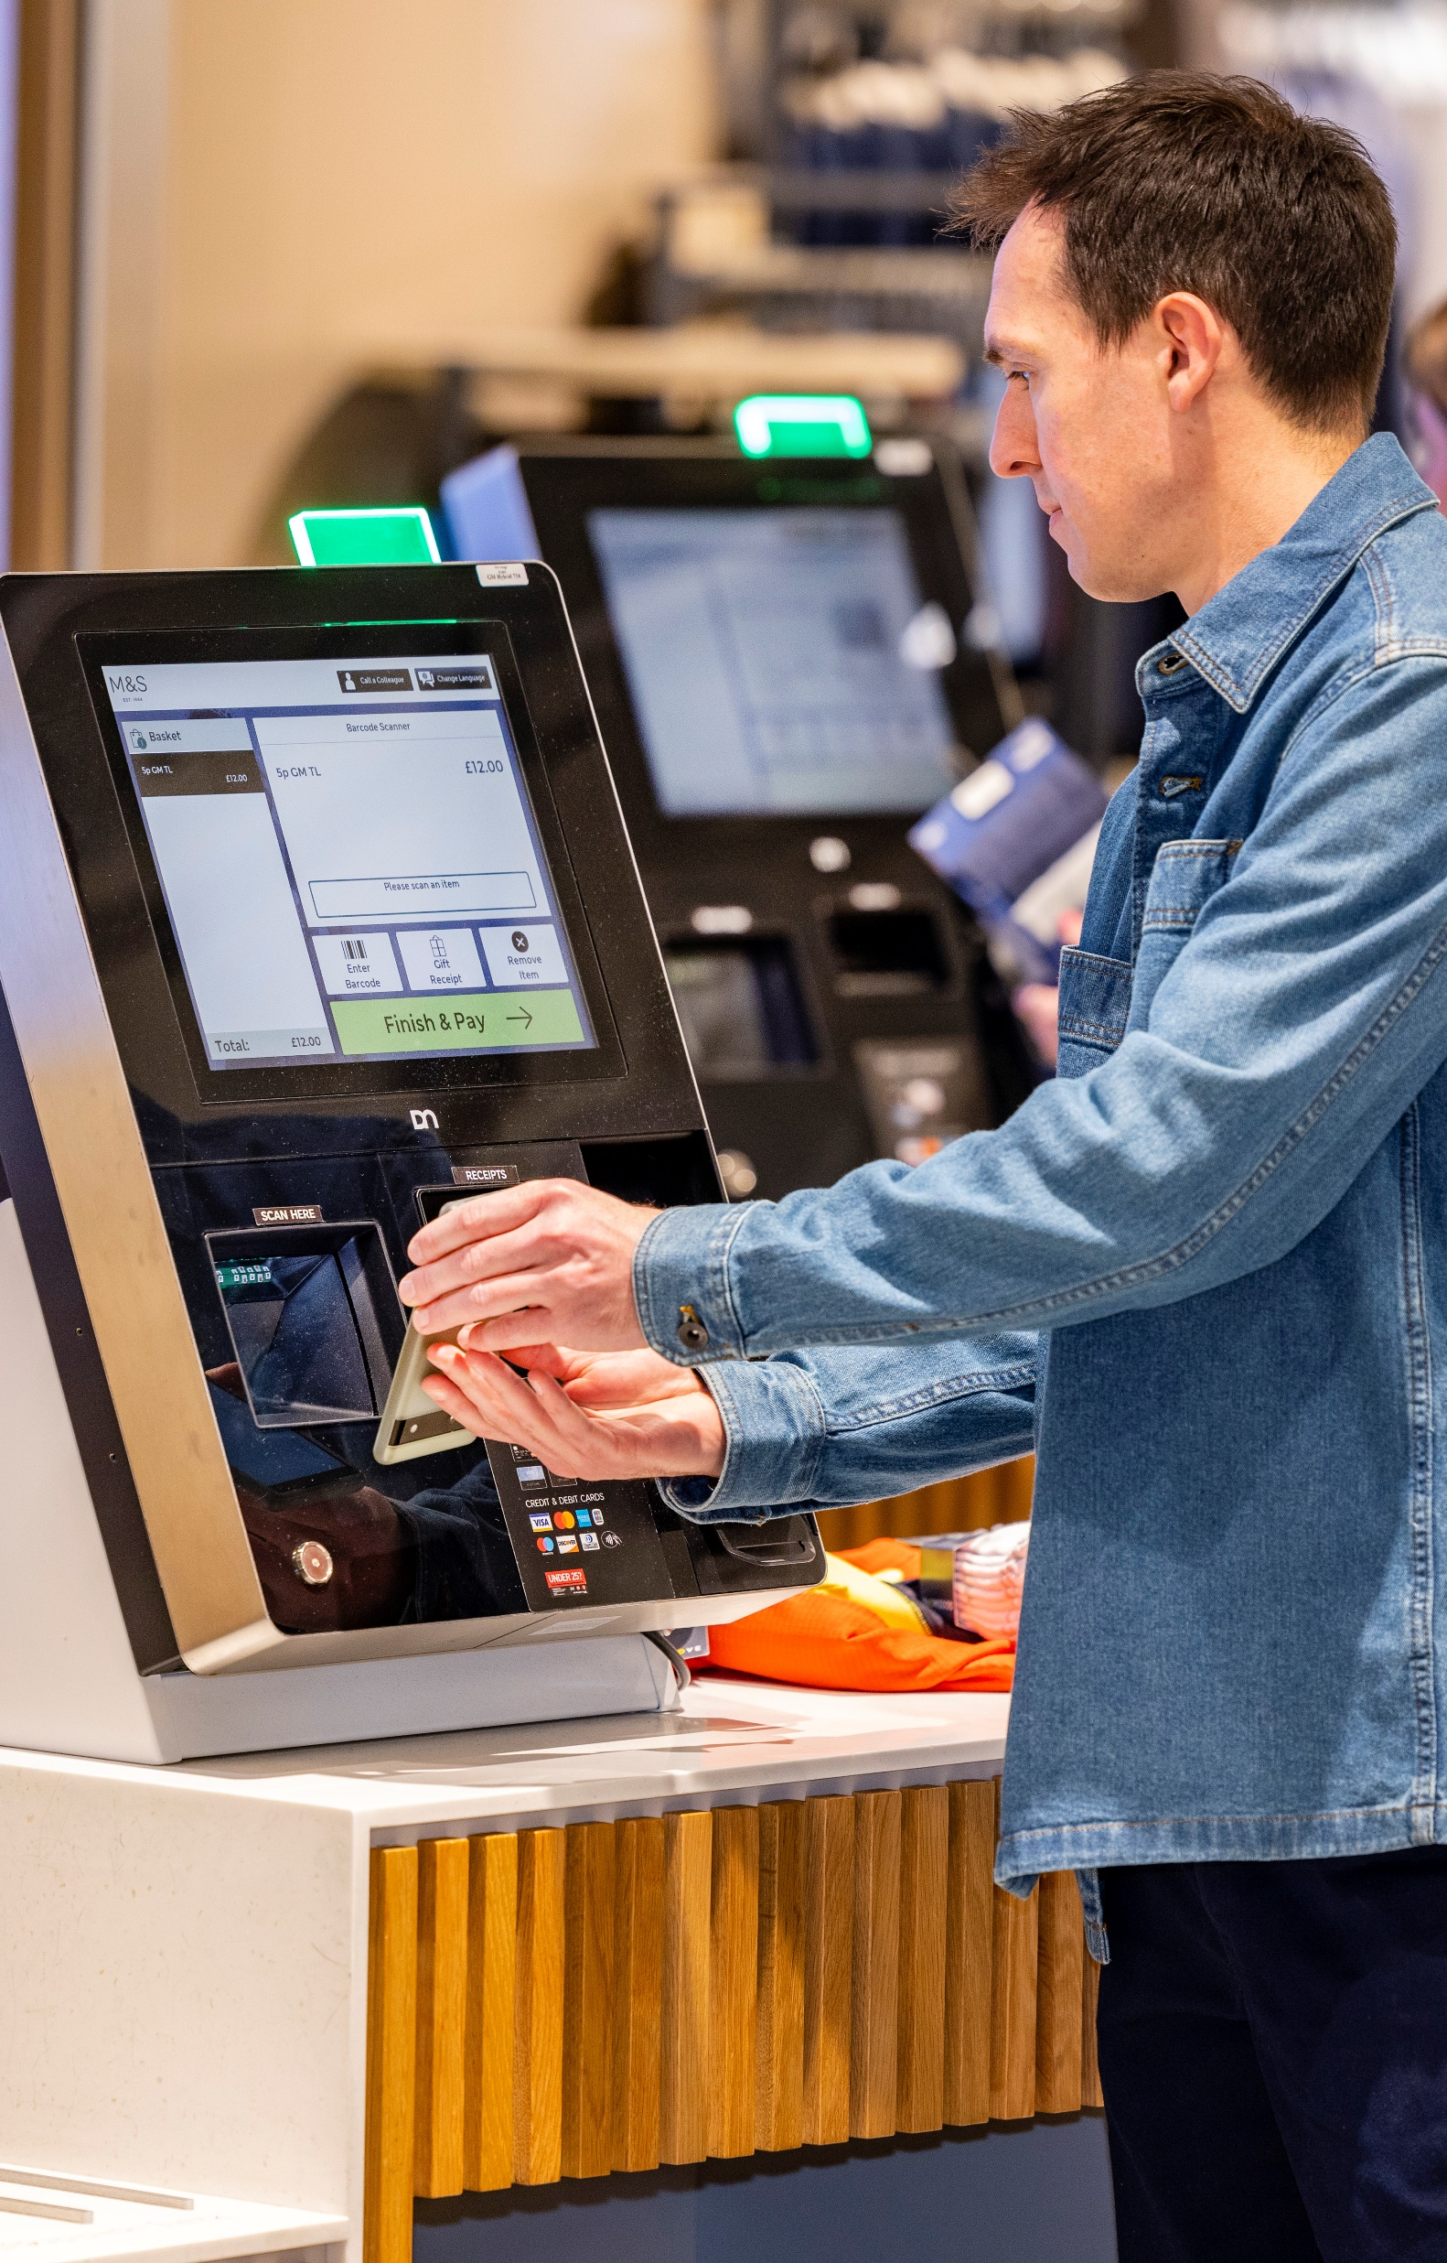
Introduction & Background
01

Slide 4
The Buying Process
This project focuses on enhancing the accuracy of size ratios of clothing - an integral part of the buying process that determines the allocation of each size to both stores and online.
Buying Process
Range Planning & Ranking
Article Cataloging & Estimates
Size Estimates
Tools: Range Planner PLM & SSI SRT & ESRT

Slide 5



The Business Problem
Summary of the inefficiencies of the current Size Ratio Tool
Relies on Historic Sales Data
Not an accurate view of demand due to stockouts
Often sparse for new or low selling products
Manual Approach
Requires significant manual analysis from buying teams
Products are manually grouped, or hierarchical categories are used
Poor Accuracy
High error rates, particularly for new products
Leads to 9% Lost Sales, 10% unsold stock resulting in an opportunity of an additional £40M a year
How can we improve Size Ratio estimation to reduce inefficiencies, increase accuracy and recover lost sales?

Slide 6
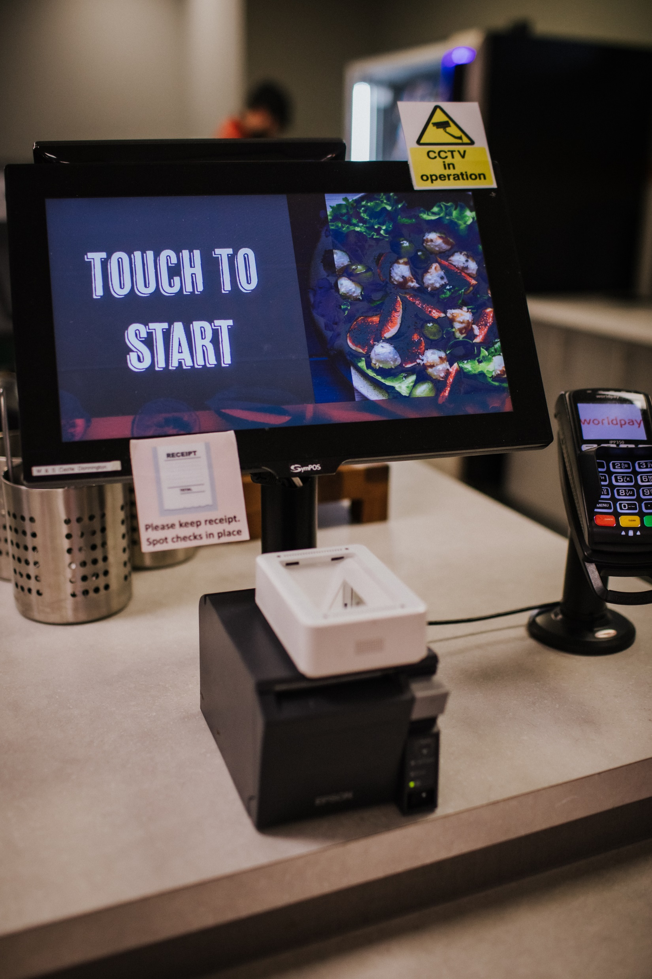
Methodology & Project Scope
02

Slide 7



Methodology & Justification
Justification of methodology used to address the Business Problem
Create a reliable view of demand
Combine actual sales and time series forecasted “lost sales” for article variants out of stock.
Data requirements to have demand by units per day
Quick to build and implement
Easily scalable as new products are added
Method aligns with other data products, ensuring one version of the truth
Automate manual approach
Use ML techniques to cluster similar products based on demand and attributes.
Superior handling of complex patterns
Can handle vast data and a high number of product features
Easily scalable as new products are added
Enhanced reliability and speed than manual selection
Improve Accuracy
Use clusters to recommended size ratio estimates and ML methods to classify new products, with no historic demand, into clusters.
Better consistency in approach
ML methods have more objectivity
Easily scalable as new products are added
Provide quantifiable and consistently higher accuracy

Slide 8



Project Scope
Given the extended lead times of the buying process, I focussed on an initial POC in Menswear to demonstrate value with potential for a future live trial and later expansion. Measures of success included achieving technical and business scope as well as outperforming current SRT estimates in accuracy and efficiency.
POC: Demonstrate the solution’s potential value and feasibility (Menswear)
Business Scope:
Create a reliable view of demand for menswear from 2022 onwards
Develop a model to cluster similar products and a classification model for new products
Present higher accuracy size ratios in Power BI
Technical Scope:
Use Databricks to trigger weekly runs of unconstrained sales and feature store
Track model performance in ML flow & maintain comprehensive documentation
Live Trial: Determine real world performance (Menswear)
Business Scope:
Encourage adoption of Power BI by buyers, gathering user feedback
Track Lost sales & FPST of trial products
Technical Scope:
Ensure data is deployed in Azure pipeline with advance monitoring
All models are packaged and deployed to Azure DevOps
Expanding to more BUs: Iteratively scale to include products from more BUs
Business Scope:
Create a reliable view of demand for all BUs
Assess and develop model performance with additional BUs
Explore additional integration into current systems
Technical Scope:
Ensure data is deployed in Azure pipeline with advance monitoring
All models are packaged and deployed to Azure DevOps

Slide 9

Model Selection & Evaluation
03

Slide 10
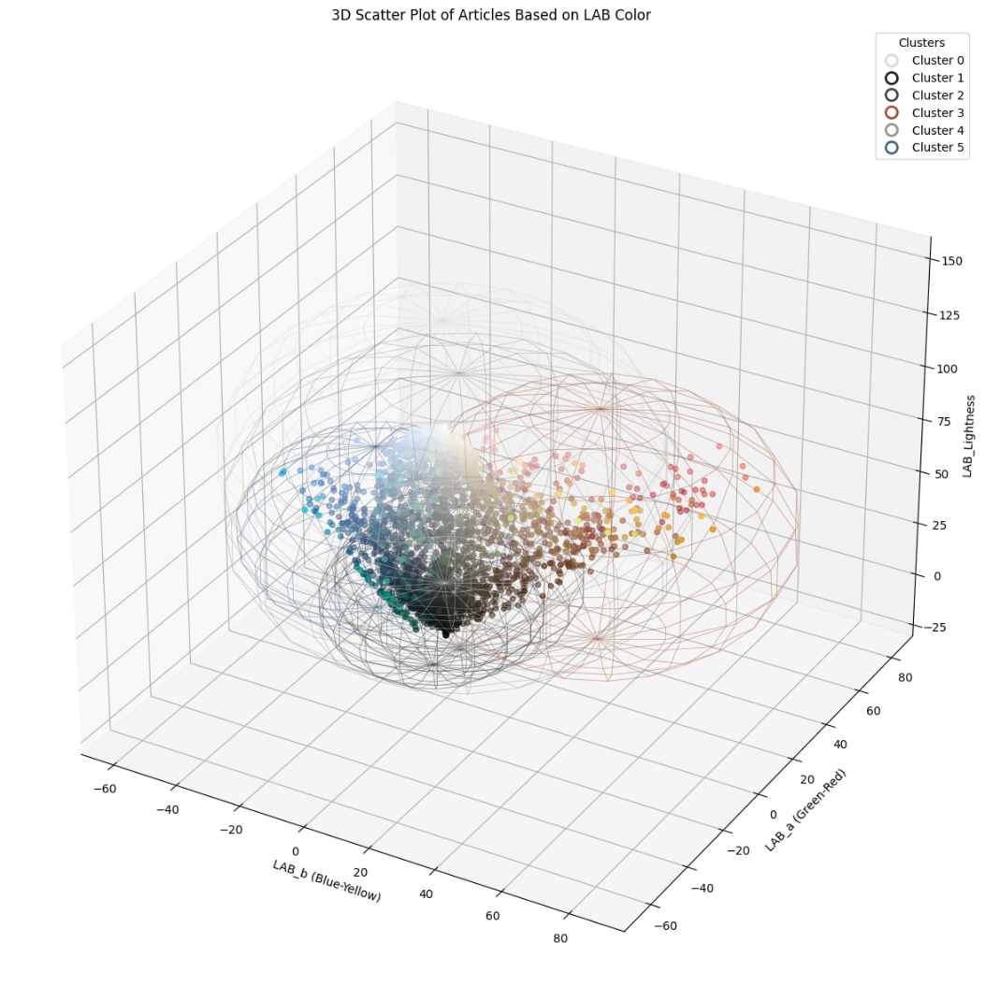
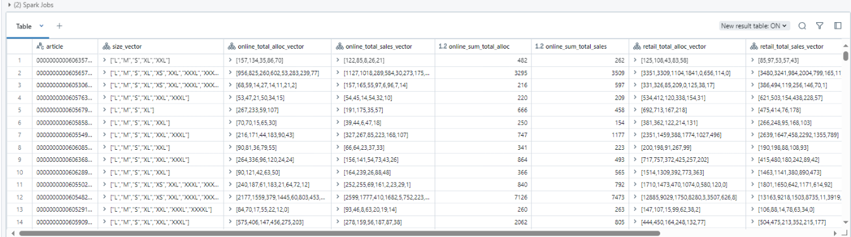
Feature Creation
During data curation and processing I complied strictly with GDPR and M&S policies. Along with best practices in code refactoring, table optimisation and consistent documentation.
Demand Size Ratios
To create a view of demand while OOS, I tested several simple moving average approaches, achieving 72% accuracy. Combined with actual sales this represents 'unconstrained sales’. This allowed the creation of custom features such as: total_sales_vector. (vector of unconstrained sales by size) and size_ratio_sales (vector of size ratio by unconstrained sales).
Product Attributes
In exploring the use of colour names as a feature, I identified over 100 different colour names selected by individuals, which introduced a level of label bias. To address this, I undertook the additional task of creating new colour names by clustering products based on their LAB colour scale attributes.

Slide 11
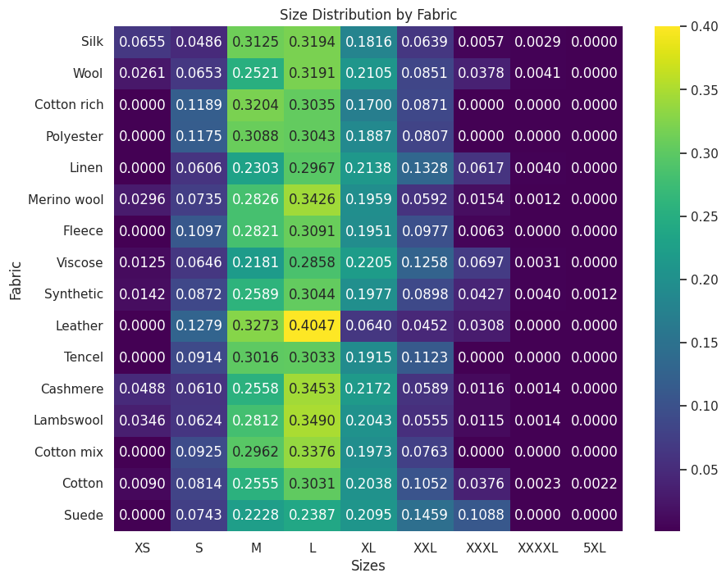
Feature Selection
I evaluated possible features prior to any modelling activities. This included data testing with checks for nulls and errors.
Average Size Ratio by Fabric type
Feature Evaluation and Encoding
High error rates meant some attributes were redundant across 90% products, these were eliminated.
Heatmaps, showed correlations of size ratios with features such as Fabric. For example, Linen was more popular in larger sizes, whereas Leather was more popular in smaller sizes.
Colour trends indicated light and bright shades are more popular in larger sizes.
Price band analysis suggested cheaper clothing is more popular in smaller sizes.
Remaining categorical features were One Hot encoded or manually mapped if ordinal.
Notes:
I standardised and used quartile categorisation for total demand to ensure a relative comparison and handle outliers.

Slide 12
Clustering
Model Selection
 | Ease to Implement | Suitability to Features | Efficiency & Scalability | Transparency
K means | Easiest: Simple & Few parameters | Suited: if categorical processed | Highest: can handle vast data | Highest: Simple Logic & easy to visualize
GMM | Moderate: More complex & Parameter Estimation | Suited: can handle mixed data types | Lowest: Computational Complexity & poor Scaling | Lowest: Complex Probabilistic Model
DBSCAN | Hardest: Complex & Parameter Sensitivity | Unsuited: as struggles with high dimensionality | Moderate: Parameter Sensitivity & no iterations | Moderate: Rule Based
Model Evaluation
 | Optimal Number of Clusters (K) | Silhouette Score | MAPE of Size Ratios | MAPE vs Baseline (% diff)
K means | 22 | 0.369 | 13.08% | -28.2%
Bisecting K means | 12 | 0.319 | 15.29% | -16.08%
Notes:
Responsibility of a high financial risk

Slide 13
Classification
Model Selection & Evaluation
 | Ease to Implement | Suitability to Features | Efficiency & Scalability | Transparency | Accuracy
Logistic Regression (multinomial) | Easiest: Simple & quick to train | Suited: if categorical processed | Highest: Computational efficiency & can deal with vast data | High: Simple Logic & easy to explain | 0.99
Decision Tree | Moderate: Straightforward | Unsuited: struggles with high dimensionality | High: Quick to train | Highest: Simple Logic & easy to visualize | 0.39
Random Forest | Hard: More complex & slow to train | Suited | Moderate: higher resource requirements | Moderate: Complexity from Ensemble Approach | 0.79
GBM | Hardest: More parameter tunning | Suited | Low: Computationally intense | Low: High complexity | 0.99

Slide 14
Results & Recommendations
04

Slide 15
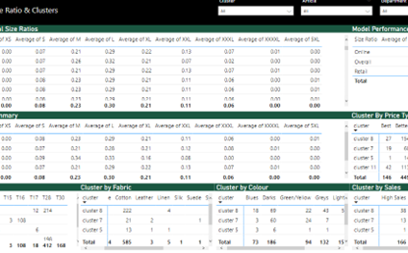
Results & Recommendations
Achieved Deliverables
Outperformed Size Ratio Baseline with 28% reduction in MAPE
Automated size estimation process using cluster averages
Recommendations presented in Power BI, with data pipeline triggered in Databricks
Recommendations
Conduct a live trial in menswear using Power BI recommendations
Track improvements in FPST & Lost Sales

Slide 16
Risks, Limitations & Implications
05

Slide 17



Risks & Limitations
Several Factors may influence the success of this solution, certain steps will need to be taken to mitigate this.
Adoption
Effectiveness of the solution may vary based on how buyers use and interpret the recommendations.
User feedback from buyers is essential
Data Structure Changes
Could impact model performance.
Fully automated monitoring and alerting should be introduced
Scaling
More advance models may be required as new BUs are added. Need for iteration and refinement of models as solution is scaled
Integration into buying system
Due to the complex eco-system in buying, there is interdependency with other factors that may impact performance.
Effective communication and consideration of these interdependencies is required

Slide 18
Thank you, Q&A

